Slide 1
NAME : JAISHREE R REG NO. : 730321104015 NM ID : au730321104015 DEGREE : B.E - CSE YEAR : III COLLEGE NAME : BUILDERS ENGINEERING COLLEGE
3/21/2024 Annual Review

Slide 2
PROJECT TITLE
CNN-BASED CIFAR-10 CLASSIFIER​
3/21/2024 Annual Review

Slide 3


AGENDA
PROBLEM STATEMENT​
PROJECT OVERVIEW​
WHO ARE THE END USERS?​
SOLUTION AND ITS VALUE PROPOSITION​
THE WOW IN YOUR SOLUTION​
MODELLING​
RESULTS​
3/21/2024 Annual Review

Slide 4

PROBLEM STATEMENT
The CIFAR-10 dataset consists of 60,000 32x32 color images in 10 classes, with 6,000 images per class. The dataset is divided into 50,000 training images and 10,000 testing images. The goal of this project is to build a Convolutional Neural Network (CNN) model that accurately classifies these images into their respective categories.​
3/21/2024 Annual Review

Slide 5

PROJECT OVERVIEW
Explore and preprocess the CIFAR-10 dataset. Design and train a CNN model for image classification. Evaluate and optimize the model for improved performance. Experiment with different CNN architectures, including various convolutional and pooling layers, to find the optimal model configuration. Utilize techniques such as data augmentation, batch normalization, and dropout to enhance the model's robustness and generalization ability.
3/21/2024 Annual Review

Slide 6

WHO ARE THE END USERS?
Researchers and Practitioners in Computer Vision
Data Scientists and Machine Learning Engineers
Educators and Students
Developers and Engineers
General Public
3/21/2024 Annual Review

Slide 7

YOUR SOLUTION AND ITS VALUE PROPOSITION
SOLUTION:
This solution outlines the step-by-step process for building, training, evaluating, and deploying a CNN-based CIFAR-10 Classifier, emphasizing data preprocessing, model architecture design, training optimization, deployment considerations, and documentation requirements.
VALUE PROPOSITION:
High Accuracy and Reliability
Efficiency and Scalability
Flexibility and Customization
Educational Resource
Time and Cost Savings
Continuous Improvement
3/21/2024 Annual Review

Slide 8

THE WOW IN YOUR SOLUTION
The "wow" factor in the CNN-based CIFAR-10 Classifier solution lies in its ability to seamlessly combine cutting-edge deep learning techniques with practical applications, resulting in a powerful tool with significant value for users.
Exceptional Accuracy
Efficiency and Scalability
Educational Value
Practical Applications
Time and Cost Savings
Decision Support and Insights
3/21/2024 Annual Review

Slide 9
MODELLING
Teams cam add wireframes
Define Model Architecture
Convolutional Layers
Pooling Layers
Flattening
Fully Connected Layers
Regularization Techniques
Model Compilation
Model Summary
Visualization
Model Training and Evaluation
Fine-Tuning
3/21/2024 Annual Review

Slide 10
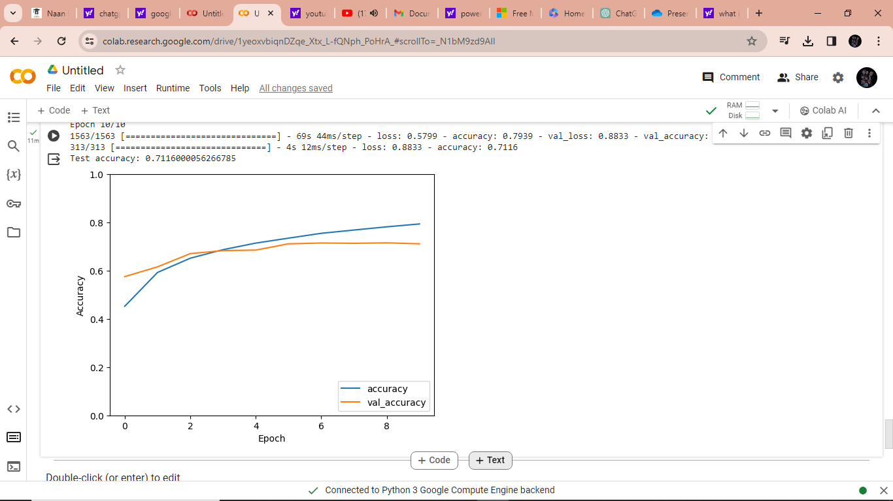
RESULTS

